Slide 1



Use case 1 : Apache httpd
Goal: Run multiple Apache HTTP server containers on the same host.
Container – 1
Container -2
What you will learn?
Docker images and containers.
Building an image from Dockerfile.
Running multiple containers out of an image.
List all images and Containers.
Stop/Start Containers
Inspecting Images and containers
Host Operating System (Windows, MAC OSX, Linux)
Docker Engine
Infrastructure / Server
Introduction

Slide 2
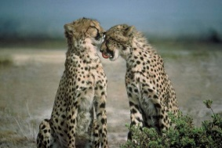

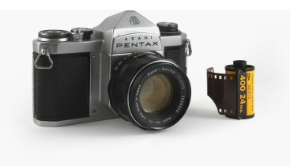
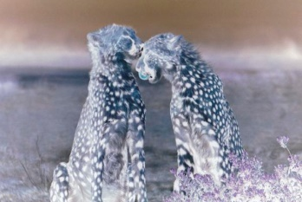
Docker Image
Analogy between the Docker Image & Camera
Docker Image
Container-1
Dockerfile
Container-2
Introduction

Slide 3
Review the Dockerfile
Introduction

Slide 4
Create an image from the Dockerfile
Introduction

Slide 5
Create a container from the image
Introduction

Slide 6
Review logs of the container
Introduction

Slide 7
List all containers
Introduction

Slide 8
List all images
Introduction

Slide 9
Stop and Start Containers
Introduction

